Slide 1
Ch11 Design Patterns(3)
——Indirection (Decoupling)
——Runtime Registration
Software System Design and Architecture
Ding Er-Yu
Software Institute, Nanjing University

Slide 2
Main Contents
Indirection (Decoupling)
Runtime Registration

Slide 3
De-Coupling Methods
Avoiding Repetition: Do it Once
  Duplication always implies coupling, because changing one piece of duplicate code implies changing the other
DIP
  Defining an interface in a module that a separate module intends to implement is a fundamental way to break dependencies and reduce coupling.
Indirection

Slide 4
DIP
Is DIP is a kind of Indirection?
Abstractions should not depend on details.
Details should depend on abstractions
Policy
Layer
depends on
Mechanism
Layer
depends on
Utility
Layer
Policy
Layer
depends on
Policy Service
Interface
Mechanism
Layer
depends on
Mechan. Service
Interface
Utility
Layer

Slide 5
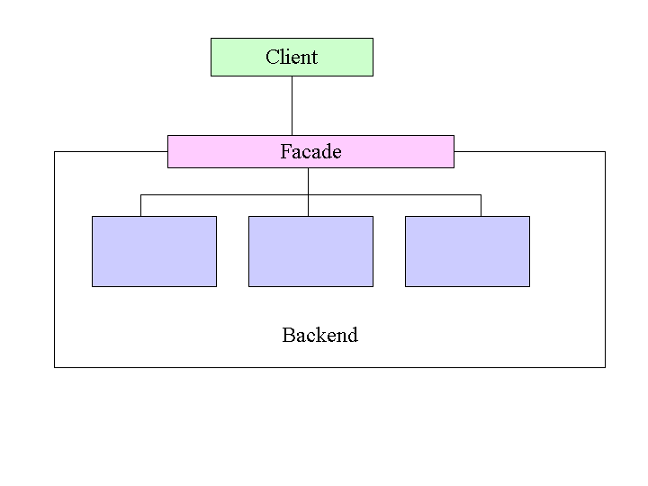
The Facade Design Pattern: Solution
  Consequences
  it decouples a client from a subsystem of components.

Slide 6
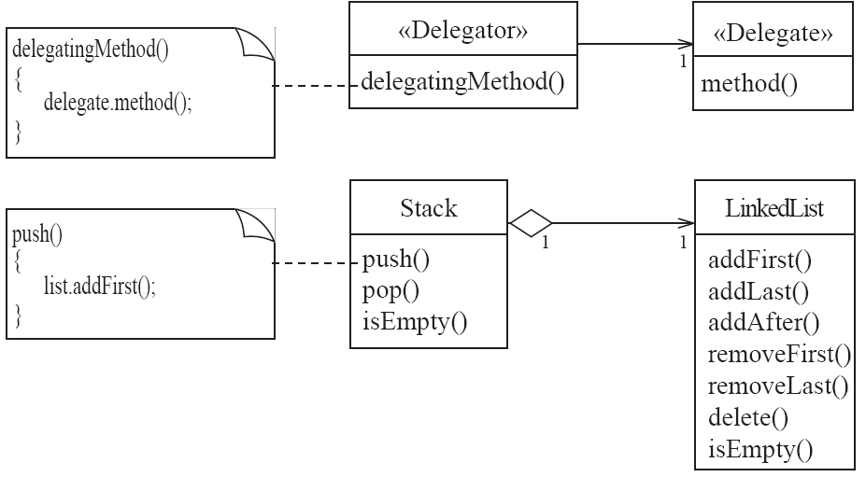
Delegation
Is delegator enough?

Slide 7
The Proxy Pattern: Solution
Subject
{abstract}
Client
Request()
The Problem
  Provide a surrogate or placeholder for another object to control access to it
RealSubject
Proxy
refers to
->Request()
Request()
Request()

Slide 8
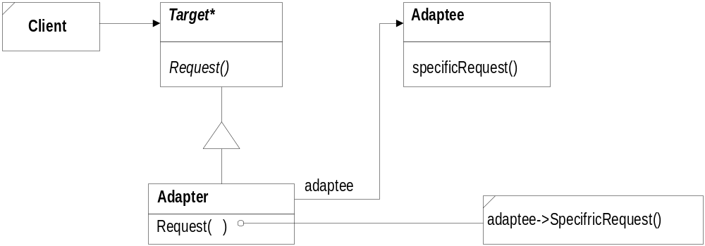
Adapter Pattern
—— Adapter Solution

Slide 9
Adapter Pattern
—— Adapter Problem
The Adapter Pattern converts the interface of a class into another interface the clients expect.
Adapter lets classes work together that couldn’t otherwise because of incompatible interfaces.

Slide 10
可以应用Adapter的常见情景有哪些?

Slide 11
Mediator Pattern
Problem
  A set of objects communicates in well-defined, but complex ways. Often with unstructured dependencies.
  Reusing objects is difficult because it refers to and communicates with many other objects.
  A behavior that’s distributed between several classes should be customizable without a lot of subclassing.

Slide 12
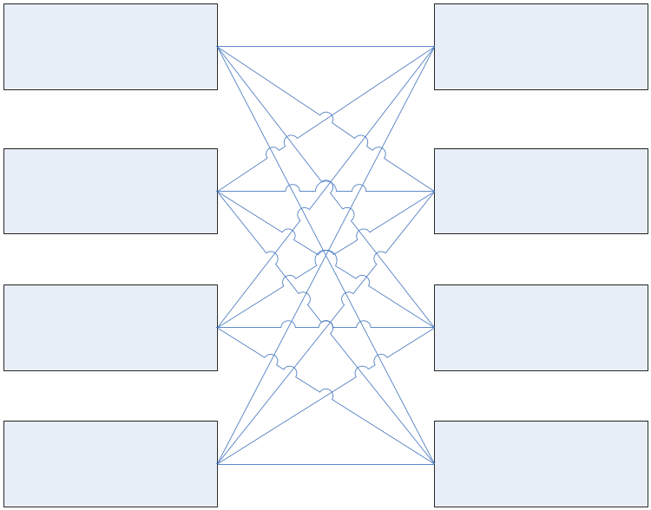
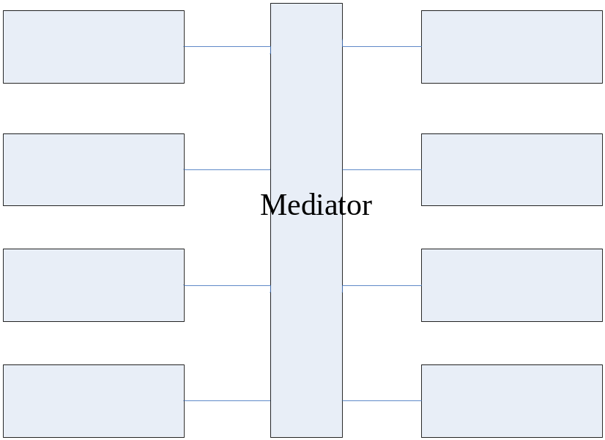

Slide 13
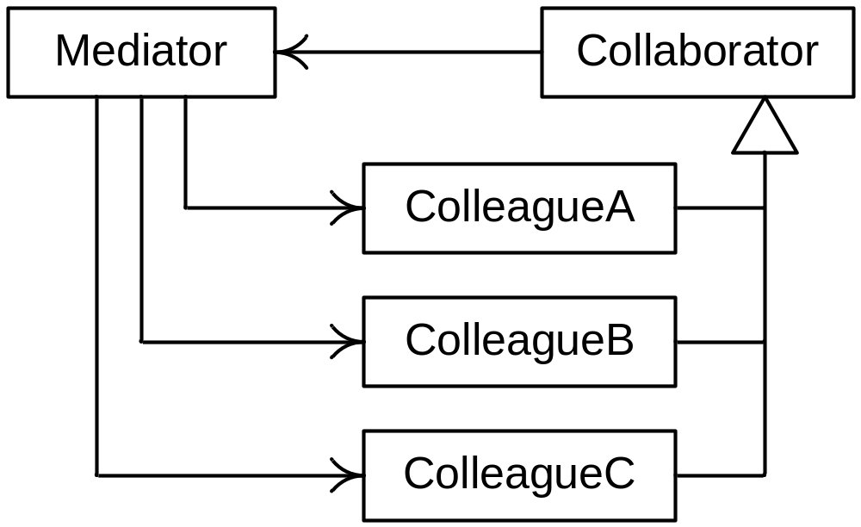
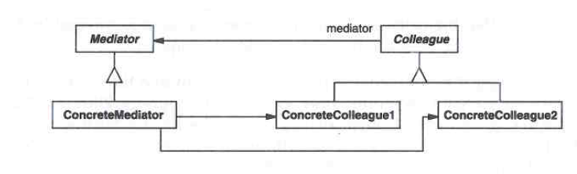
Mediator Pattern Structure

Slide 14
Participants
Mediator
  – Defines an interface for communicating with Colleague objects
  – Typically mediator is informed of some event or situation
ConcreteMediator
  – Implements cooperative behavior by coordinating Colleague objects
  – Knows and maintains its colleagues
Colleague classes
  – Each Colleague class knows its Mediator object
  – Each colleague communicates with its mediator whenever it would have otherwise communicated with another colleague
  – Offers services (requests) to mediator
  – There may be requests that are common to all colleagues, as well as specific ones.

Slide 15
Consequences
Define an object that encapsulates how a set of objects interact.
Mediator promotes loose coupling by keeping objects from referring to each other explicitly
Lets you vary their interaction independently
Centralizes control

Slide 16
思考题
用Mediator Pattern 模拟实现麻将游戏的框架
  四人，其中一个为庄家
  顺时针游戏顺序
  只模拟摸牌、出牌、吃牌、碰牌、槓牌和胡牌行为
  不要求详细的行为判断规则

Slide 17
Main Contents
Indirection (Decoupling)
Runtime Registration

Slide 18
Runtime registration and Call-backs
A callback is a client method that can be registered to a server object so that the server can call it back
  Example: registration of client code to be called when server catch user events
They are a mechanism for extensibility

Slide 19
Call-back: message sequence chart
Client
User
Server
Client installs callback
User calls server
Server invokes callback
Callback queries server
Callback returns
Calls
Results
Server returns

Slide 20
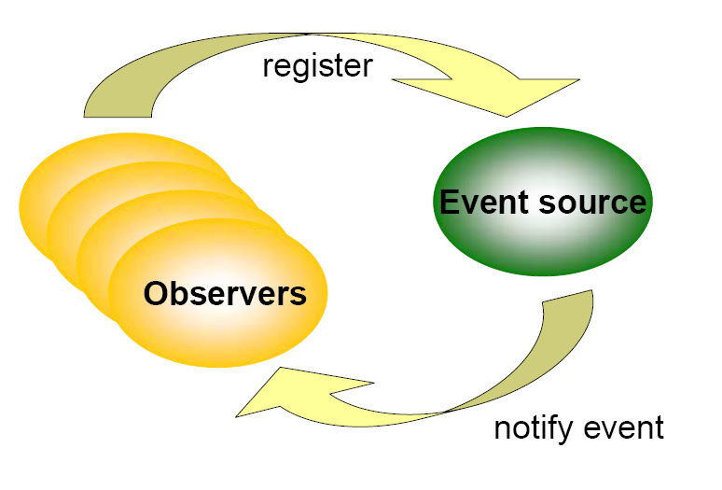
Observer Pattern
——Observer and Event

Slide 21
Observer Pattern
——Problem
Define a one-to-many dependency between objects so that when one object changes state, all its dependents are notified and updated automatically

Slide 22

Observer Pattern
——Solution

Slide 23
Observer Pattern
—— Consequences
Flexibility, changeability, and reusability
  Low coupling with “event” style
More complex
  More difficult for comprehension and test

Slide 24
Observer Pattern
—— Summary
Use the Observer pattern in any of the following situations:
  When a change to one object requires changing others, and you don't know how many objects need to be changed.
  When an object should be able to notify other objects without making assumptions about who these objects are. In other words, you don't want these objects tightly coupled.

Slide 25
思考题
用observer编写程序：
  Model: student（ID, name, birthday）
  View:
    View1: 显示 ID+name
    View2：显示ID+birthday
    View3：修改student的三个列
  View1~2为observer，model为subject
    实现每次view3中实现修改后
    View1~2自动更新

Slide 26
思考题
与真正自实现的Event Style相比，Observer Pattern的不同在哪里？
如果众多Observer的接口不相同怎么办？
  不都是update接口，甚至不是同一种类型

Slide 27
Command Pattern: Problems
parameterize objects by actions they perform
specify, queue, and execute requests at different times
support undo by storing context information
support change log for recovery purposes

Slide 28
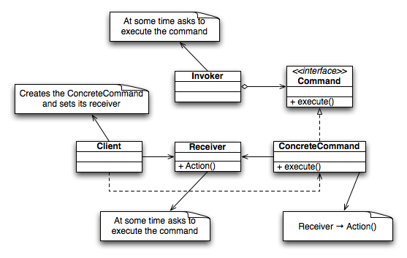
Command Pattern: The Solution

Slide 29
UNDO/ REDO: Command
public abstract class AbstractCommand {
public abstract boolean do();
public abstract boolean undo();
}
public class SalesCommand extends AbstractCommand {
//private historybehavior;
update() {//delegate to others, update new data, establish historybehavior}
clear() { //delegate to others, clear updated data according to historybehavior}
public boolean do() {
update();
return true; //undoable
}
public boolean undo() {
clear();
return true;
}
}

Slide 30
UNDO/ REDO: Command
//this would possibly be a good candidate for singleton class also
Class CommandManager {
private int maxHistory = 100;
private List<AbstractCommand> undo;
private List<AbstractCommand> redo;
public void synchronization() {
//for all concrete command
if (command.do()) {
addToUndo(command);
}
}
public void undo( ) {
//for each command of undo List
if (command.undo()) {
undo.clear(command);
addToRedo(command);
}
}

Slide 31
Command Pattern
Consequences:
  decouple receiver and executor of requests
  You can store Commands in a stack or queue
    Command processor pattern maintains a history
  easy to support undo and redo
    must add state information to avoid hysteresis
  can extend commands more easily

Slide 32
Any Q?

